Slide 1

NASAC 2018
CLDIFF: Generating Concise Code Differences
Kaifeng Huang¹, Bihuan Chen¹, Xin Peng¹, Daihong Zhou¹, Ying Wang¹, Yang Liu², Wenyun Zhao¹
¹Fudan University, China
²Nanyang Technological University, Singapore
kfhuang16@fudan.edu.cn
Notes:
大家好，我是来自复旦的黄凯锋。 那由我来介绍一下我们的原型工具

Slide 2




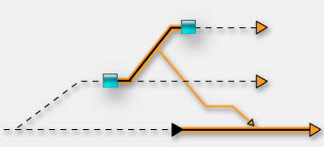

Code Differencing
Code R1
Code R2
Code differencing is useful
How to generate, represent
and use code differences?
Code Review
Code Merge
Regression Testing
Notes:
首先介绍一下工具的应用背景。目前软件开发都是依靠版本管理工具，git svn等。而目前的工具都是依赖于基于文本的差异比较工具，其差异结果中没有代码本身语法结构的信息。所以如果仅仅使用文本差异工具的内容，再去后续分析方面存在很多不足。 那我们的工具的出发点就是要去弥补这个问题。 首先代码差异应用可以有很多，举例来讲，现在的code review中其实主要还是依靠人来看。 其次 在代码merge中，很多merge conflict都是因为基于文本的diff算法的误报引起的， 。 再者，在回归测试中，依靠代码结构的差异分析，可以减少回归测试集合。

Slide 3
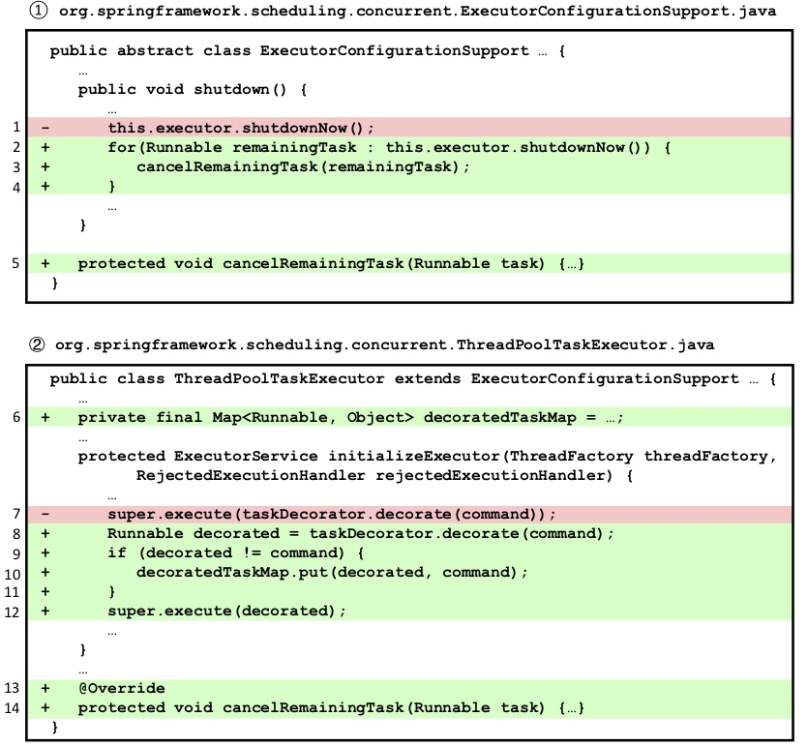
Motivating Example
Method addition and invocation
Field and local variable declaration
For loop and if
Notes:
首先看一下这个例子。这里两个文件，红色和绿色标注的是git svn等内置基于文本的工具所展现的差异内容。然而对于开发者而言，实际上他看这片代码呢，是分几个部分的。。。。。。 所以我们需要引入AST抽象语法树解析来引入其语法结构。

Slide 4
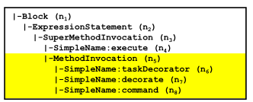
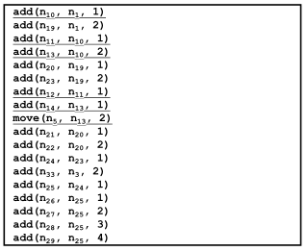
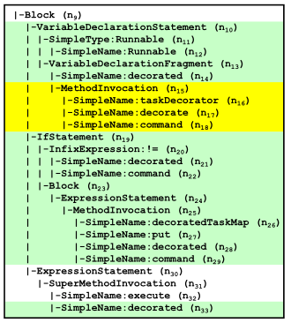
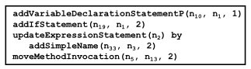
Motivating Example (cont.)
Tree-based Edit Action
Partial AST before Code Change
update(n,v) - node level
add(n,p,i) - node level
delete(n) - node level
move(n,p,i) - subtree level
Edit Script by GUMTREE
Edit Script by CLDIFF
Partial AST after Code Change
Notes:
接着看一下基于树结构的差异分析的过程。左： 中： 右：

Slide 5
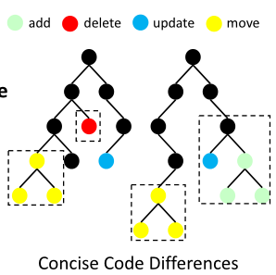
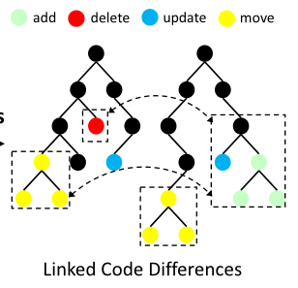

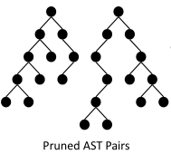
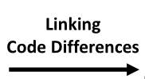
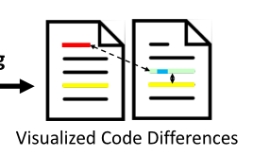
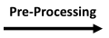
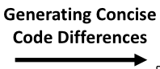
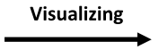
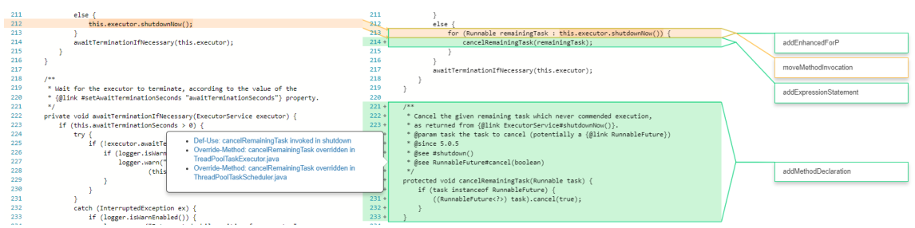
Methodology
Notes:
PG7-8:
This is an overview of our approach. Taking as inputs a set of source code files before and after changes, CLDIFF works in three steps.
First, it preprocesses source code files and prune unchanged subtrees.
Second, it groups fine-grained code differences at or above the statement level and generates a concise code difference.
Third, it links the related concise code differences heuristically. And lastly the visualization
The figure gives a snapshot of our visualization tool and you can see how CLDIFF works. The bubble on the right is a concise code difference edit script and the bubble on the left shows the links.

Slide 6
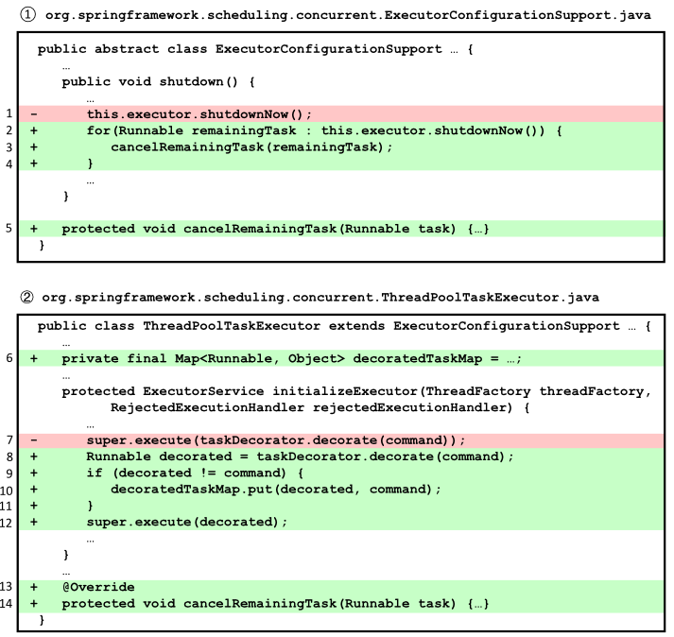
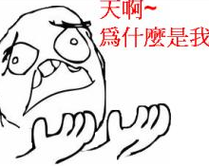
Example of Linking Code Differences
“Where is the variable used?”
Linking code differences
Def-Use Link
decoratedTaskMap
decorated
cancelRemainingTask
Abstract-Method Link
cancelRemainingTask
Notes:
然后再来看一下这个例子

Slide 7
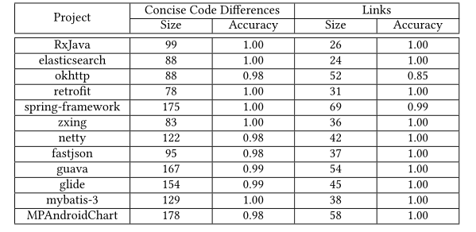
Accuracy Evaluation
ClDiff generated concise code differences and established
their links with an accuracy of 99% and 98%,respectively
Notes:
然后是对我们工具做的一个实验评估，结果显示CLDiff生成代码差异的同时，能够保持高准确度

Slide 8
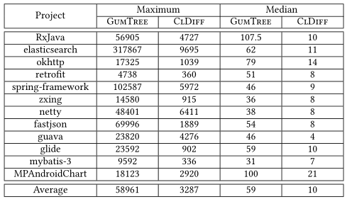
Conciseness Evaluation
ClDiff generated more than 80% shorter edit script for 48% commits
Notes:
For RQ2, we run the entire 12 projects, which are thousands of commits in total. The red rectangle shows the size of code diffrences that gumtree generates and the blue rectangle shows the size of code differences that CLDIFF generates.
Length of Code Differences by CLDIFF is magnificently reduced compared to GUMTREE

Slide 9
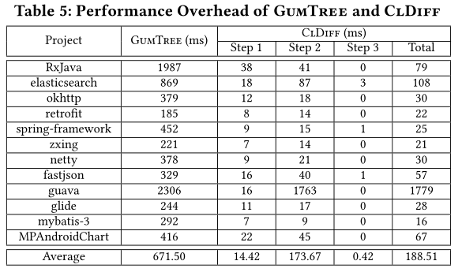
Performance Evaluation
ClDiff generated shorter edit script with 72% shorter time
Notes:
For RQ3, we compare the average performance overhead of GUMTREE and CLDIFF. It also reports the performance overhead in each step.
The table shows the performance overhead of gumtree and CLDIFF. CLDIFF generates concise code differences while manages to process in a short time

Slide 10
Thank You! Q&A?
Kaifeng Huang¹, Bihuan Chen¹, Xin Peng¹, Daihong Zhou¹, Ying Wang¹, Yang Liu², Wenyun Zhao¹
¹Fudan University, China
²Nanyang Technological University, Singapore
kfhuang16@fudan.edu.cn

